Slide 1
Working Group Clusters of Excellence
Progress Report
SG PA 8 Chisinau, MD
Dr. Sigrid Winkler
8-9 April 2014

Slide 2
Projects and structure of DanuClus
Automotive Industry
Core Group
HORIZONTAL
TOPICS
Active Ageing
Innovation and Gender
ICT
Online Platform
Green Technologies / Climate Change
Internationalization
Creative Industries
Mapping and benchmarking
Next Generation Competitiveness Initiative (OECD)
INNOVATION
Service Innovation
Training and best practice exchange
CLUSTER OPTIMIZATION
Notes:
Innovation:
Existing economic strengths
Strong clusters
Grand societal challenges
Cross-sectoral
Automotive Industry: Donau Motor (Till Truckenmüller BW/BG, Roman Biro SK, Igor Vijatov RS)
Active Ageing: MHC? Wood: ID:Wood, Rohstofflieferanten, Überholzlehrgang – Zusammenhang Social Innovation
Green Technologies/Climate Change/Sustainable Manufacturing: Umwelttechnik BW, WG Environmental Technologies (Rumjana Hilpert); UC, NREE; Kläranlagen
Service Innovation: TMG
Creative Industries: RO; Creative Region
ICT: Advanced Manufacturing / Industrie 4.0: TMG
Cluster Optimization
COG: Training
Mapping, Online Platform: ECCP
Online Platform: ClusterPoliSEE E-Learning Platform ??
Benchmarking: ESCA; Accreditation: ClusterCOOP
Best Practice: From the region
Horizontale Themen:
Internationalization: visit to China, contact with BSR
Innovation and Gender: Lucia Seel, Gisa Schosswohl, Petra Püchner
NGCI: Ausweitung auf EUSDR-Länder außerhalb des westlichen Balkans

Slide 3

Funding of DanuClus
INTERREG
EUROPE
Danube Programme
ESCP
Cross-Border Programmes
BY/AT; AT/CZ; AT/SK
COSME
Horizon 2020
Central Europe Programme
Notes:
Idea is not to find funding for whole initiative, but funding for separate projects
Test bed: use cross-border programme for projects in order to bridge the time until the start of the transnational, interregional programmes
TAF: Support

Slide 4
for DanuClus
Identification of potential funding sources and relevant calls
Report on Danube Region Programme
Clarification of new State Aid rules for cluster projects in EU funded programmes
Definition of specific objectives and scope of DanuClus initiative
Start: April 2014
Duration: 6 months

Slide 5

Next Steps for DanuClus
30 April 2014
Thematic Workshop
→ Project Ideas
→ Potential Partners
→ Funding
July 2014
Funding Workshop
Pitch of project ideas to potential funders
→ Finetuning

Slide 6
30 April 2014, Vienna: Thematic Workshops
DanuClus
Automotive Industry
Core Group
HORIZONTAL
TOPICS
Active Ageing
Innovation and Gender
ICT
Online Platform
Green Technologies / Climate Change
Internationalization
Creative Industries
Mapping and benchmarking
Next Generation Competitiveness Initiative (OECD)
INNOVATION
Service Innovation
Training and best practice exchange
CLUSTER OPTIMIZATION
Notes:
Automotive
Biomass
Smart Furniture Manufacturing
Creative Industries
Cluster Optimization
Innovation & Gender

Slide 7
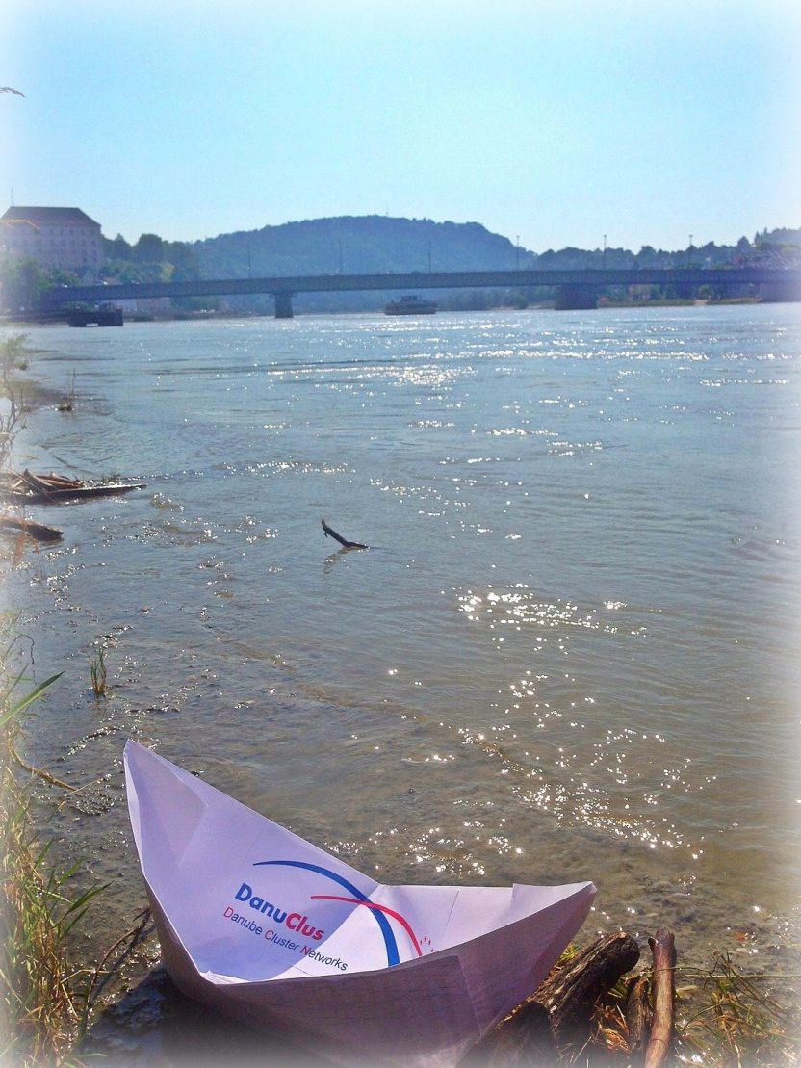
More information on DanuClus ?
Dr. Sigrid Winkler
Technologie- und
Marketinggesellschaft m.b.H.
+43 732 79810 5093
sigrid.winkler@tmg.at
http://groupspaces.com/Competitiveness/

