Slide 1
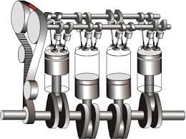
DonauMotor
Innovation Motor Automotive
in the Danube region

Slide 2


AGENDA
Automotive Cluster Bulgaria
Goals
Members
Activities
DonauMotor project
Basic project facts
Objectives and benefits
Geographical location
Project phases
MoU
Project ideas
2

Slide 3
ACB objectives
Support automotive industry companies
Attract automotive manufacturers, OEMs, Tier1, Tier2 suppliers
Support projects of ACB members
Represent interests of ACB members in all matters
Stimulate ethical market relationships
Develop and support implementation of training and edu. measures
Represent and support the development of the automotive industry in BG
3
Notes:
Founded in July 2012, by 8 companies as a non-profit organization which represents the interests of automotive manufacturers, suppliers and organizations providing services for the automotive industry.
Those with headquarters or subsidiaries in Bulgaria in setting-up and further development of production, assembling, R&D, sales or service.
Demonstrate locational advanta­ges of Bulgaria over other Eastern European countries, the Middle East and North Africa. All these tasks aiming to make a major contribution to the future growth of the Bulgarian industry.
Introduction of technical improvements and innovations, optimization of quality, structures and processes to reduce costs and increase competitiveness in international markets
Corporate government and compliance to be in line with European directives.
Together with government, universities, private training providers and ACB members in matters pertaining to education and training, development of technology centers.

Slide 4

























ACB members
31 MEMBERS over 12.000 employees in BG, 650.000 worldwide
leschke.design
4
Notes:
ACB fosters synergies between the cluster members and supports their business growth and competitiveness through participation in international joint projects, case studies and professional automotive qualification programs.

Slide 5
ACB activities
Conferences
8-10/10/2013: IACB. More than 200 participants. Over 20 exhibitors.
30/09–1/10/2014: International HR Conference. More than 100 participants.
Trainings
Training center, co-project with FESTO and SMC.
HR and Financial focus groups
Meetings between the members on specific topics
EU projects and tenders
OP, HORIZON 2020, EC and Cross-border Program funds
5
Notes:
IACB keynote speakers: Mercedes-Benz Cars, Hyundai Motor Europe, Robert Bosch AG, Volkswagen AG, BASF, BHTC, Porsche AG, Baden-Württemberg Ministry of Finance and Economics, etc.
HR conf. keynote speakers – MLSP, Magna Powertrain, Software university, FESTO Production, Liebherr, Melexis Sebn, ABB, KPMG

Slide 6
DonauMotor
Basic project facts
Supported by: the Federal Ministry of Education and Research within the Strategy of the Federal Government for internationalization of Science and research in Germany
Project Coordinator: Fraunhofer Institute for Manufacturing Engineering and Automation IPA in Stuttgart, Germany
Core team:
1. Automotive Cluster Bulgaria (BG)
2. AutomotiVest Cluster Romania (RO)
3. Moravian-Silesian Automotive Cluster (CZ)
4. Landesnetzwerk Mechatronik Baden-Württemberg (DE)
5. IMACOS Truckenmüller & Company GmbH (DE)
6

Slide 7
DonauMotor
Objectives
Main goal is to initiate an Automotive Supercluster “DonauMotor” (DanubeMotor)
Improving the competitiveness and expanding the manufacturing industry within the Danube region
Increasing R&D investment of enterprises up to 3% of GDP within the countries especially on the lower stream
Enabling the Danube Region to become the European technology axis of Best Practices
7

Slide 8
DonauMotor
Benefits
Improvement of the overall economical situation in the Region through higher demand of people, machines and material
Development of new small and medium-sized enterprises (SME)
Increasing the potential of innovations and economical performance
Contribution to increase the European stability
8

Slide 9
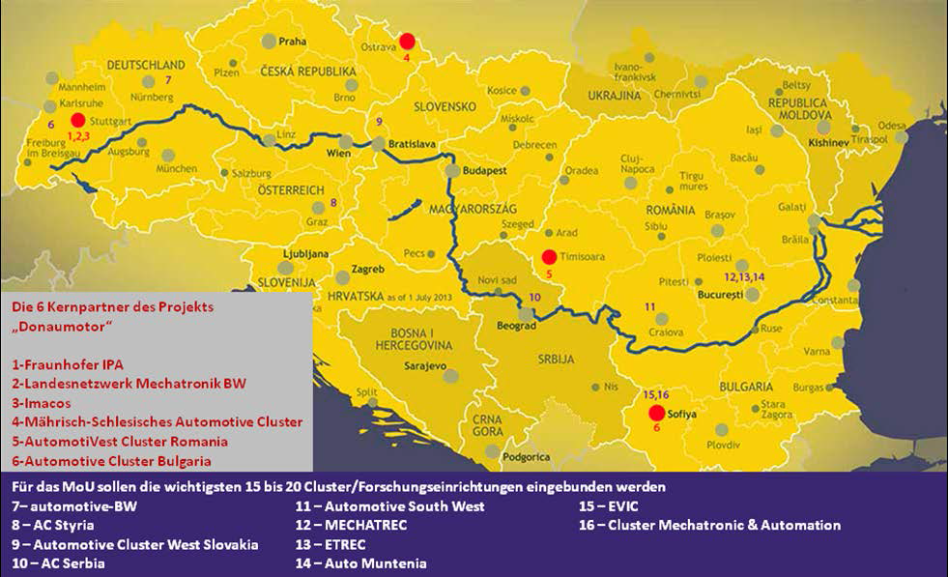
DonauMotor
Geographical location
9

Slide 10
DonauMotor
Project phases
Phase 1: Building an Innovation and technology platform
Phase 2: Approach and strategy for implementation projects
Phase 3: Realization of projects
Kick-off June 4, 2014 Start January 1, 2015
Start April 1, 2015
10
Notes:
Ph1:
Representation of existing networks
Identification of activities and competencies of appropriate clusters, technology centers and research facilities
Determination of innovation needs and potentials
Identification of industrial technology leaders and SMEs to be in the network for phase 2 is connected
Integration of industry partners
Talks / workshops on drafting platform concept
Drafting a Memorandum of Understanding (15 to 20 partners) for the formation of efficient discovery alliances for Phase 2
Ph2:
Identification of possible projects
Project planning
Budgeting
Establishing partners (Industry + Cluster / Techcenter + University)
Development of innovative industrial centers
Establishment and development of technology parks and research institutions
Design and implementation of innovation projects to improve quality, productivity and reliability in the business

Slide 11
DonauMotor
MoU 1/2
The MoU generally defines the overall program goals and describes the collaborative nature and relationship between the identified project and MOU-referenced participants. The agreement is signed by:
Clusterland Upper Austria (AU)
University of Graz (AU)
GAUSS Institute (MK)
AC Serbia (RS)
Cluster ICT (BG)
Urban Logistic Cluster (RO)
ETA2U (RO)
RimacAutomobili (HR)
11
Notes:
Clusterland Upper Austria – organization that contributes to the Upper Austria's innovation policy
GAUSS - Foundation for New Technologies, Innovations and Knowledge Transfer
Urban logistics – founded under DOROTHY project (Development Of RegiOnal clusTers for researcH and implementation of environmental friendlY urban logistics)
ETA2U – company for IT solutions
RimacAutomobili - high-performance electric vehicles, drivetrains and battery systems.

Slide 12
DonauMotor
MoU 2/2
Toolmakers Cluster of Slovenia (SI)
Unior (SI)
Mechatrec Cluster (RO)
National R&D Institute for Welding and Material Testing (RO)
Caelynx Europe (RO)
NiCAT(RS)
Vojvodina Metal Cluster (RS)
University of Split, Faculty of Electrical Engineering, Mechanical Engineering and Naval Architecture (HR)
Automotive Cluster Slovakia (SK)
Union of Slovak Clusters (SK)
12
Notes:
Unior – machine tools production
Mechatrec deals with Nano-Mechatronics Innovative Science
Caelynx Europe - Industrial processes and engineering
NiCAT - Nis Cluster of Advance Technologies

Slide 13
DonauMotor
Project ideas 1/3
Project | Lead Partner | Partners
Regional academies for trainings, including Dual education of engineers | TBD | DE, BG, RO, CZ, HR,SI, RS
Communication and Brokerage Platform (Multinational Com-munication Industrial Cluster) | Cluster ICT (BG) | DE, BG, RO, CZ, HR,SI
Auto Park Bulgaria | ACB (BG) | AU, DE, BG, RO, HR
Value network development | AutomotiVest Cluster (RO) | CZ, HR, BG, RS
3D sinter printing | AC Styria (AU) | DE, SI, RS, BG
13

Slide 14
DonauMotor
Project ideas 2/3
Project | Lead Partner | Partners
Relocation of electronic parts manufacturing to Europe | Moravian-Silesian Automotive Cluster (CZ) | DE, BG, RO, HR
Laser Cutting | Magurelle High Tech Cluster (RO) | DE, BG
Inno-Day | Clusterland Upper Austria | CZ, SI
Roadmap | Clusterland Upper Austria | DE, SI
Design of Environment | Continental | AU, RO
14

Slide 15
DonauMotor
Project ideas 3/3
Project | Lead Partner | Partners
Closed loop approaches for the reduction of critical raw materials | University of Graz | TBD
Sustainable product development as competitive advantage in the automotive industry | University of Graz | TBD
Embassies of Environment | Continental | AU, RO
???
15

Slide 16
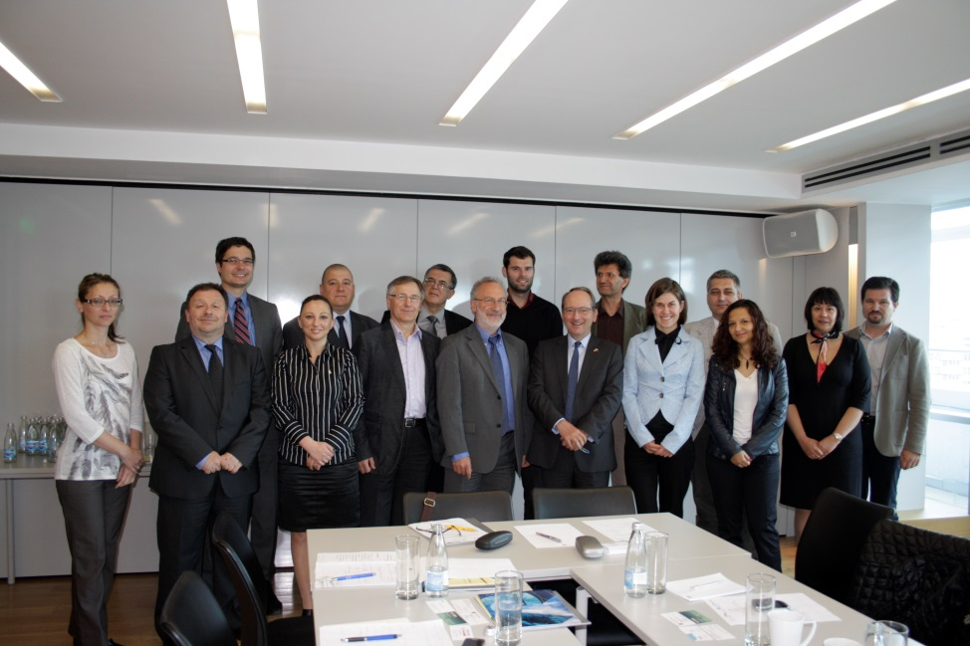
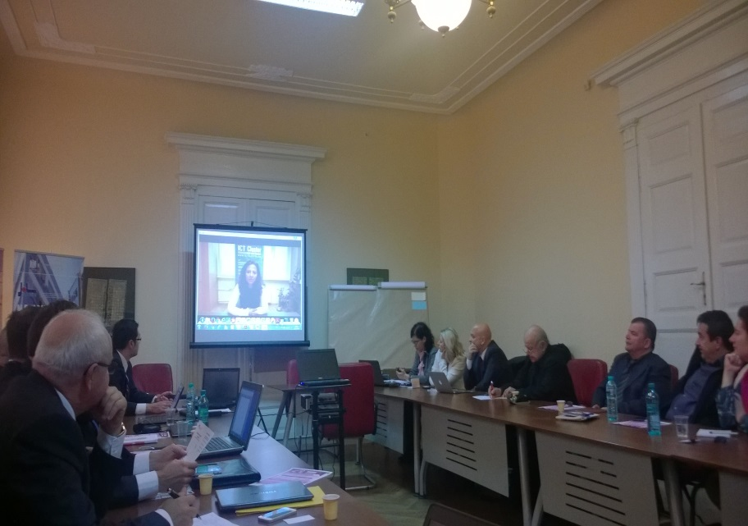
DonauMotor
Pictures from the phases
Sofia, BG, 04-05/07/2014
Timisoara, RO, 29/10/2014
16

Slide 17


Thank you for the attention!
Dilyana Stoyanova
EU Projects Manager
 dilyana.stoyanova@automotive.bg
+359 877 444 539
 +359 2 90 30 681
17

