Slide 1

Technology Transfer Centers
Steinbeis Model
-------------------------------------------------
GlobalConnect / Danube Strategy
Stuttgart, 14.11.12

Slide 2
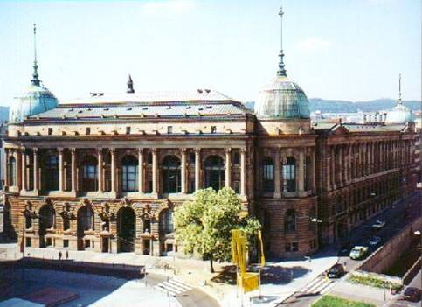
Steinbeis Network
Steinbeis-Stiftung für Wirtschaftsförderung
Steinbeis GmbH & CO.KG für Technologietransfer
more than 850 Centers for Knowledge and Technology Transfer
697 Professors
+ 1.462 employees + 3.631 project based experts
Turnover in 2011: 134 Mio. €
about 9.000 customers per year
about 15.000 projects per year
Steinbeis University
private, self-financed university
Headquarters: Stuttgart

Slide 3
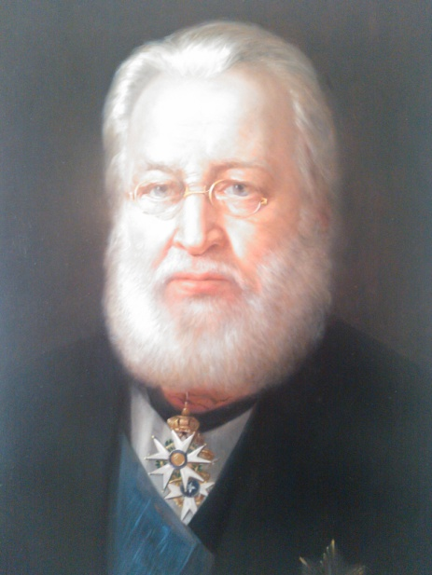
Ferdinand von Steinbeis (1807-1893)
Technical advisor, director and chairman of the Headquarter for Trade and Commerce (1848-1880) Kingdom of Württemberg (Stuttgart)
Promoter of technology transfer
Founder of vocational schools, weaving and
women‘s schools
Promoter of the industrialization in Württemberg
Father of dual training:
„Industrial workers of the future depend upon theoretical knowledge combined with practical skills.“
Ferdinand von Steinbeis
(1807 - 1893)

Slide 4
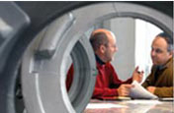
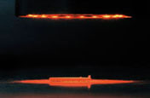

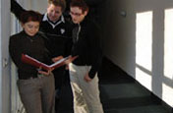
Steinbeis Services
Consulting
Research and development
Evaluation and expert reports
Training and employee development
At every stage of the value chain
Forming the basis for decision making
Fostering successful transfer
As a key competitive
factor

Slide 5
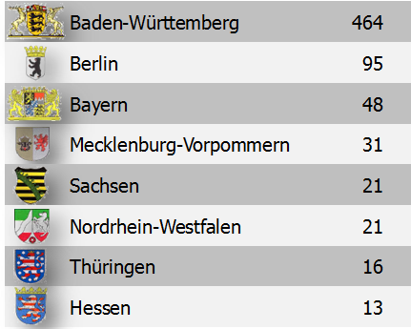
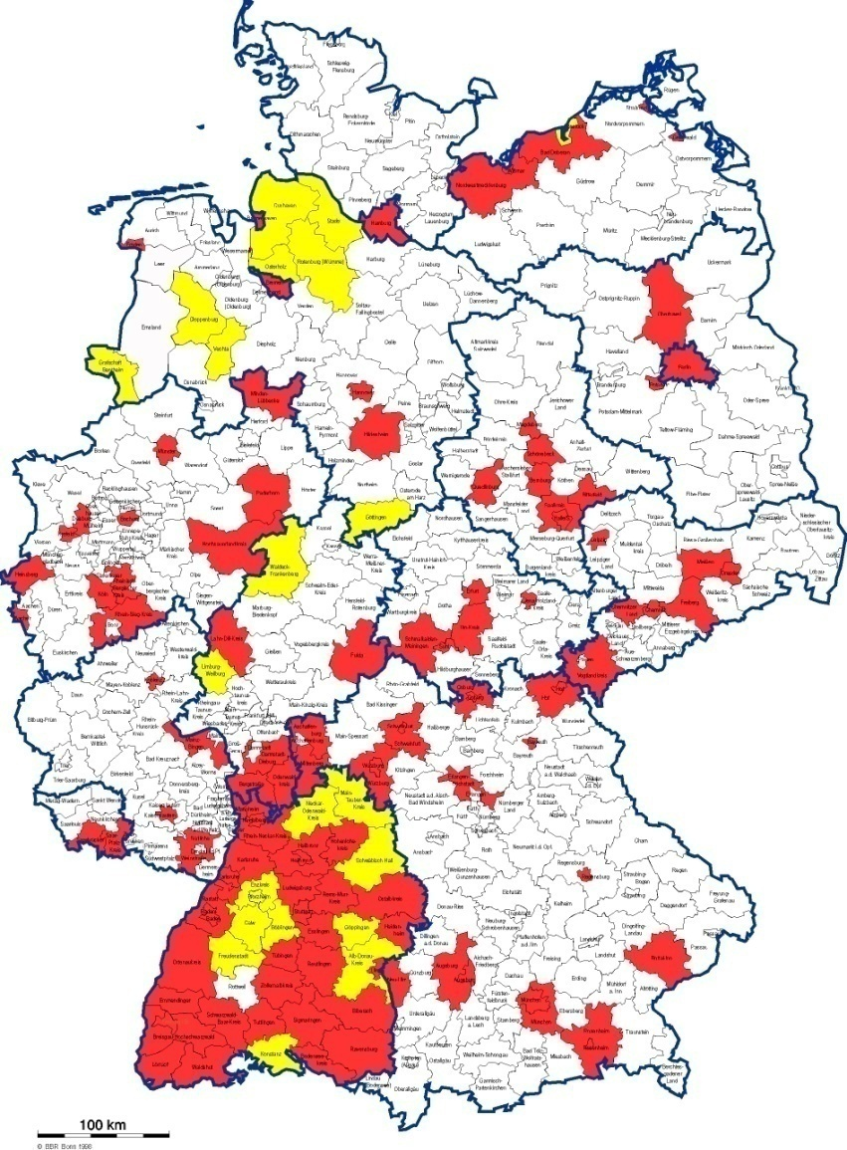
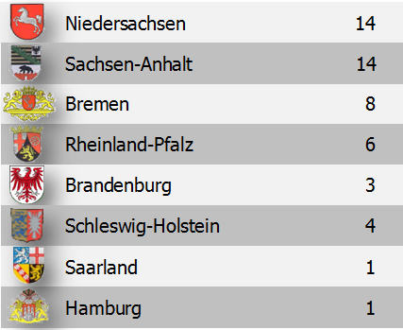
Steinbeis in Germany
Centers in 135 of 441 counties

Slide 6
Steinbeis System - Network
Link and coordinator for Science and Societies
Uni
SU
Uni
SU
SU
SU
Uni
Uni
SU
SU
Uni
SU
SU
SU
Uni
Uni
SU
SU
SU
SU
Uni
SU
SU
Uni
SU: Steinbeis Unit/Enterprise
Uni: University
Notes:
Beschreibung Steinb.
Grafik ist nicht endgültig

Slide 7

Transfer
Transfer by Steinbeis
University
Enterprise
Knowledge on markets
Services
Besonderheiten:
Kunde initiiert Projekt
Anreiz: Erlöse sind STZ-Umsatz
Arbeitsteilung: zentral/dezentral

Slide 8
Steinbeis System
University
Staff &
Students
SU
Research
Innovation potential from (SU) as driving force for economic growth
Economic problem solutions increase experiences and competences of the SU
Economic problems very often generate new research activities at universities
win
win
win
Notes:
Beschreibung STW

Slide 9

Steinbeis System – Network
Central Tasks and Management
university
staff &
students
SU
research
Source of knowledge
Knowledge and Technology
Transfer Center
Economy as user
Customer initiate project start
Solidarity principle: fees are linked to SU turnover
Division of work (central and decentral work)
Notes:
Beschreibung STW

Slide 10
Wettbewerbsfähigkeit der Donauländer
Land | Gesamtindex | Innovation | Entwicklungsstufe **
 | Rank * | Rank *
Deutschland | 6 | 5 | 3
Österreich | 19 | 13 | 3
Tschechien | 38 | 32 | 3
Ungarn | 48 | 52 | 2-3
Slowenien | 57 | 45 | 3
Montenegro | 60 | 59 | 2
Slowakei | 69 | 71 | 2-3
Bulgarien | 74 | 96 | 2
Kroatien | 76 | 82 | 2-3
Rumänien | 77 | 99 | 2
Ukraine | 82 | 93 | 1-2
Moldau | 93 | 127 | 1
Serbien | 95 | 118 | 2
Bosnien-Herzegowina | 100 | 108 | 2
* of 142 countries ** 3 = innovation driven Source: Global Competitiveness Report 2011-2012,
2 = efficiency driven World Economic Forum; table: STC
1 = factor driven

Slide 11
Wettbewerbsfähigkeit der Donauländer
Land | Gesamtindex | Innovation | Entwicklungsstufe **
 | Rank * | Rank *
Deutschland | 6 | 5 | 3
Österreich | 19 | 13 | 3
Tschechien | 38 | 32 | 3
Ungarn | 48 | 52 | 2-3
Slowenien | 57 | 45 | 3
Montenegro | 60 | 59 | 2
Slowakei | 69 | 71 | 2-3
Bulgarien | 74 | 96 | 2
Kroatien | 76 | 82 | 2-3
Rumänien | 77 | 99 | 2
Ukraine | 82 | 93 | 1-2
Moldau | 93 | 127 | 1
Serbien | 95 | 118 | 2
Bosnien-Herzegowina | 100 | 108 | 2
* of 142 countries ** 3 = innovation driven Source: Global Competitiveness Report 2011-2012,
2 = efficiency driven World Economic Forum; table: STC
1 = factor driven

Slide 12

Transfer of Best Practice
Example:
First Danube Transfer Centers are
located in
Slovakia (Bratislava, Nitra)
Romania (Cluj-Napoca)
Serbia (Novi Sad)
Pilot Project of
Baden-Württemberg
(09/2012 – 04/2014)
Implementation by
Steinbeis-Europa-Zentrum
Steinbeis-Donau-Zentrum

Slide 13

Transfer of Best Practice
Example:
„Increasing the adaptability and competitiveness of Romanian industry employees through continuous training in ITC, new technology transfer, environmental protection and pollution control”
Training of 1,100 managers in Romania (300 about innovation)
ESF-Project Romania
(09/2012 – 04/2014)
Implementation by
Steinbeis-Transferzentrum
Ost-West-Kooperationen
local partners

Slide 14
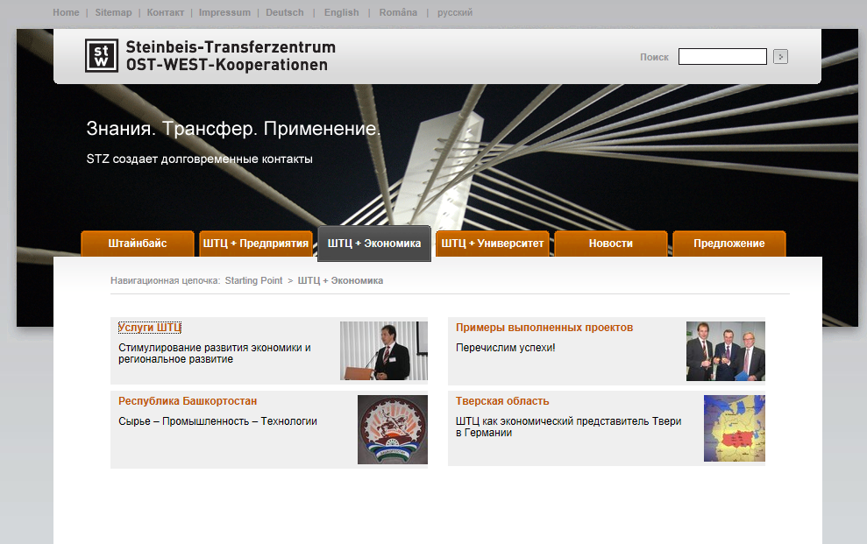
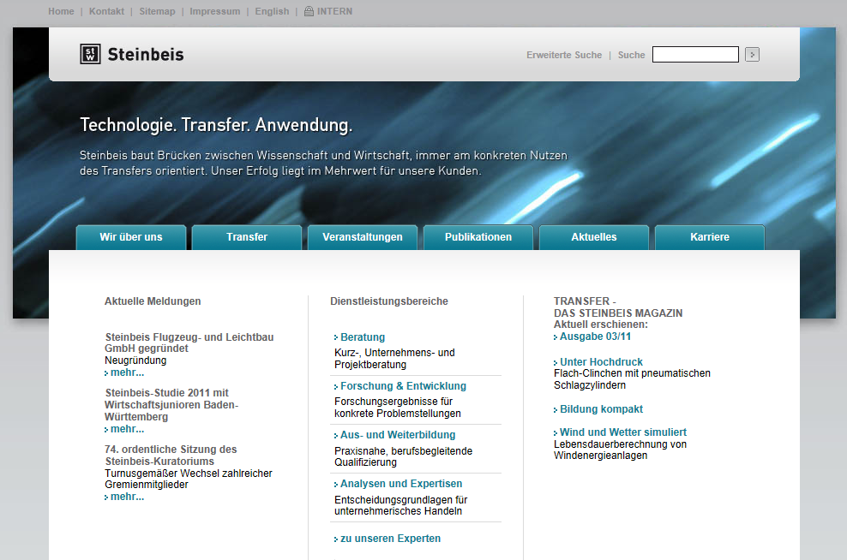
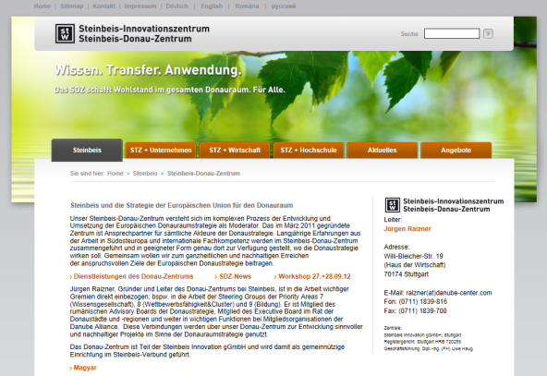
Details on Internet
www.stw.de
www.stz-ost-west.de
www.donaustrategie.eu

Slide 15
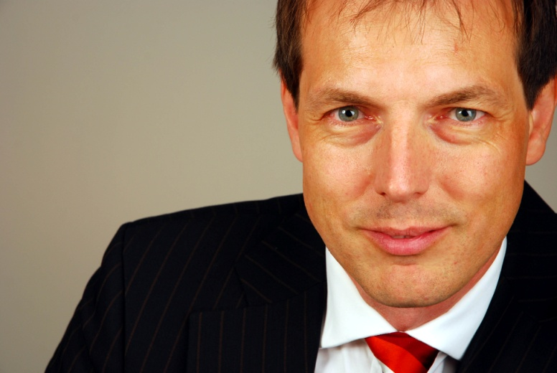

Thank you for your attention!
Jürgen Raizner
Head of Steinbeis Enterprises
STC EAST-WEST Joint Ventures
SIC / Steinbeis-Danube-Center
Steinbeis Transfer Management S.R.L.
Phone: +49-711-1839-816
Cell Ph.: +49-170-3314333
E-Mail: raizner@danube-center.com
15
Notes:
15

