Slide 1
Cluster policy in Emerging industries
New trends in regional cluster development in the Danube Region
EU Strategy for the Danube region
3rd Workshop of Priority Area 8 “Cluster Networking and Development Projects in the Danube Region
Mateja Dermastia, CEO Anteja ECG

Slide 2

Topics
Evolution of Cluster policy in Europe
Role of clusters in emerging industries and new policy tools
What is there for Danube

Slide 3

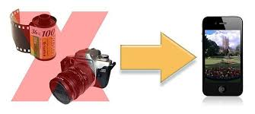

Cluster policy in EU
National and regional cluster programs
  Cluster initiatives
  Managed by cluster organizations
More than 2000 cluster organizations in Cluster Observatory
Notes:
Improve competitiveness of local industries and facilitate industrial transformation processes by stimulating the development of infrastructure in support to business innovation

Slide 4
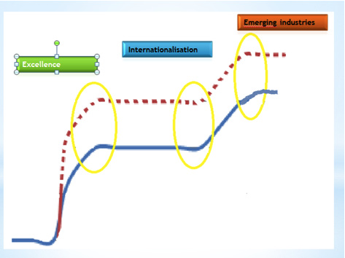
European Cluster strategy 2010 - 2020

Slide 5
Changing the Cluster Support Schemes
Long term oriented effort
Convergence of various policy domain
Funding cluster organisation
Increasing visibility of cluster initiatives
1990 – 2000
Understanding clusters
2000 – 2010
Identification of clusters
2010 – 2015
Creating better clusters
- 2020
Clusters drivers of emerging industries
Coaching cluster organisations
Quality labelling for cluster excellence
Needs oriented services
Cross-cluster cooperation
Cross-sectoral cluster cooperations
Cross regional collboration
International strategic partnerships
Source: Meier zu Köcker, 2014

Slide 6
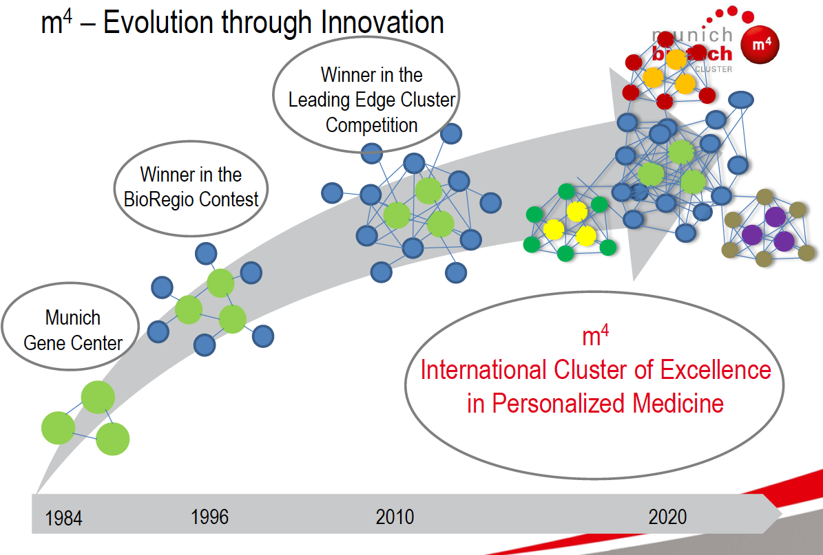
BioRegio

Slide 7
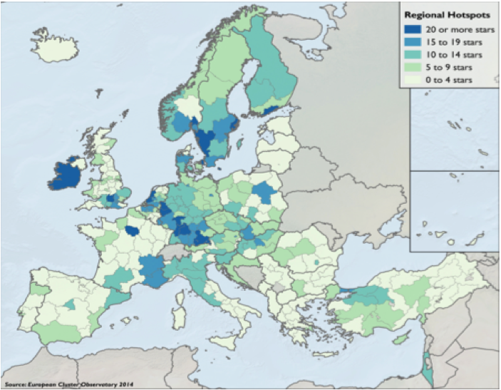
Innovation hubs in Europe
Cluster panorama, 2014
Actors in the world market
Attracts talents
Function as ecsystem – rapidly reacting to market opportunities
Facilitating the development and growth of
  of entrepreneurial, technology or creativity driven firms
  new industrial sectors

Slide 8
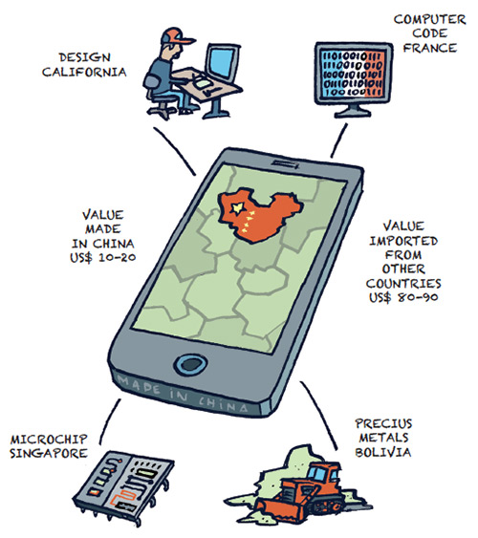
New global value chains
Relying on local resources for innovation is no longer a sufficient strategy for rapid economic transformation and dynamic growth of new industries.
The convergence of ideas from different places,
Use knowledge available in different places
Emerging with accelerating speed

Slide 9
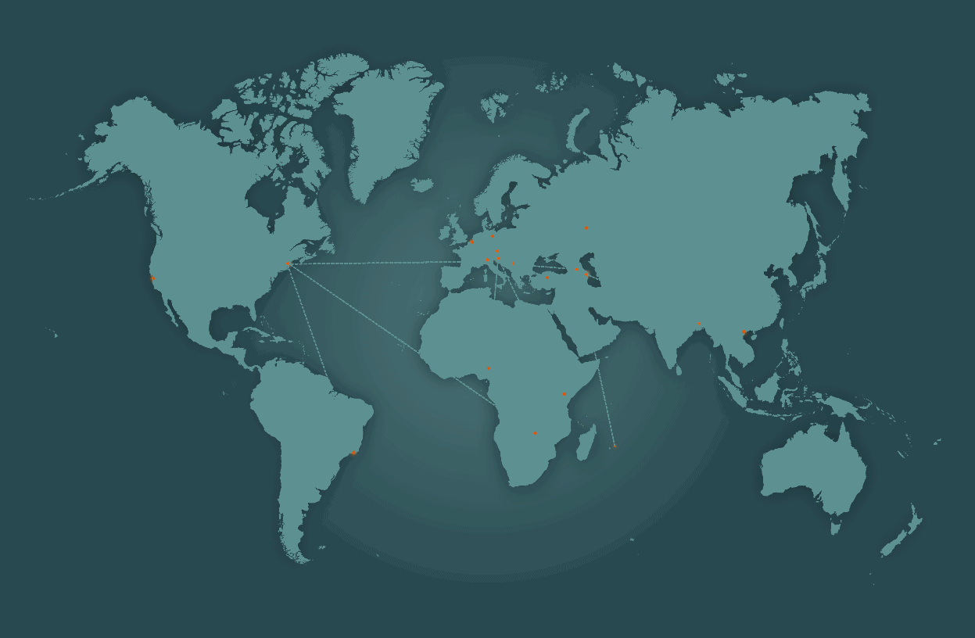
Convergence of policy domains
Research
Transformation of € into competencies and knowledge
Entreprenurship
vehicle of innovation
Inovation
Transformation of knowledge and competencies into €
NETWORKS
Regional and Global

Slide 10
Cluster policy and cluster organizations role is well established in traditional industries while emerging industries remain a challenge
Policy Challenge

Slide 11


Addresses the challenges of Slovenia’s innovation policy
A new policy model for a systemic approach to stimulating the transformation of the industrial structure
Emerging Industries
Clusters
New value chains

Slide 12

Structural change from
polymer to biopolymer based industry ➔ bio-based industry in Europe.
Agricultuture, Health, Safety, Mobility, Food…
  bio-chemicals,
  bio-materials
  bio-plastics
  next generation of bio-energy

Slide 13
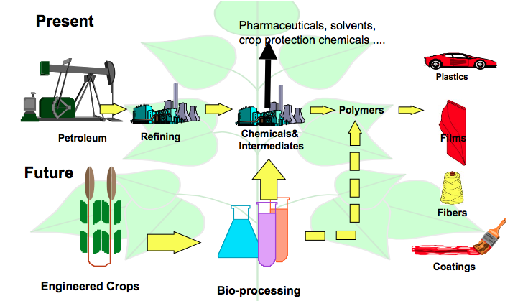
Changing the way how to produce and use polymers

Slide 14
Testing new policy tools and combination
Understanding strengths and weaknesses of
  policy approaches and measures / programs
  innovation capacity
  cluster organizations
New tools and combination of tools
Stress Test and peer review of policies
Benchmarking of cluster organizations

Slide 15
  Stress test and Peer Review
  Trans - regional policy learning among peers
Understanding of different models to foster bio-polymer industry as an emerging industry
Towards better regional cluster and innovation policy
Strengths and Weakness with regard to the establishment of new industrial value chains
Outreach the regional boarders and sectors
ž

Slide 16
Stress test and peer review
Peer Review &
Benchmarking
Comparing among participants
Policy Learning & Improving
Comparing with Reference Group
Peers: Bavaria, Saxony, Lower, Upper Austria, Flander and Slovenia

Slide 17
Countries in which at least one region will participate in the peer review on cluster policies
Notes:
I have marked all countries where at least one region indicated ist interest to participate !

Slide 18
Key dimensions of policy conducive to bioeconomy identified
Bio economy - strategic policy objective
Involvement of relevant actors in the policy development process
Financial support through thematic and generic programmes
Innovation hubs
Clusters as catalysts and cross-border collaboration.
Slovenia has to improve all of above mention dimensions!

Slide 19
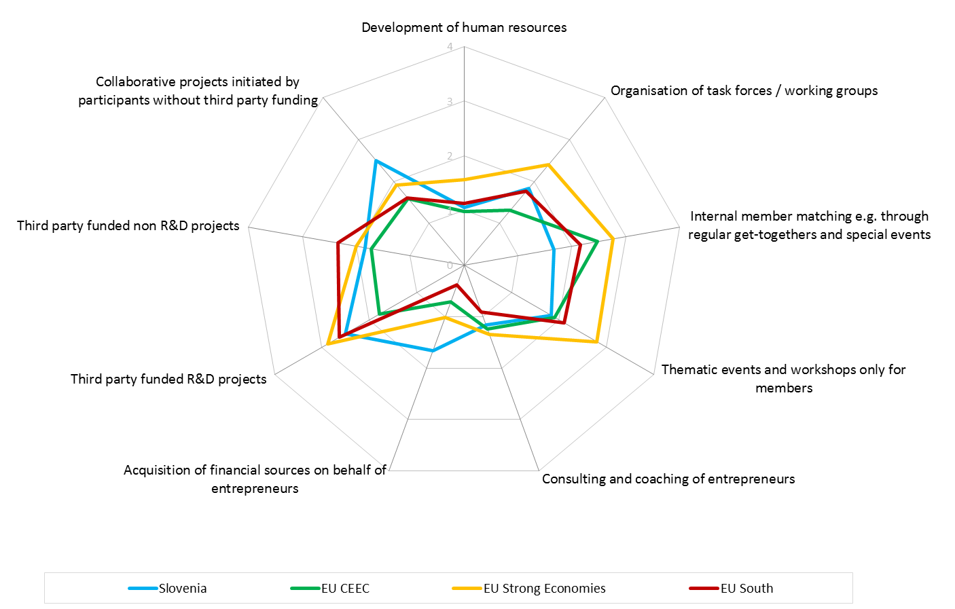
…….reflecting in low intensity of services offered by cluster organizations …

Slide 20
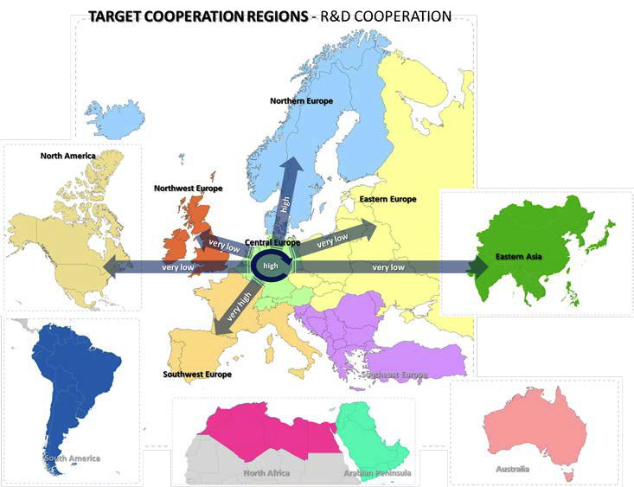
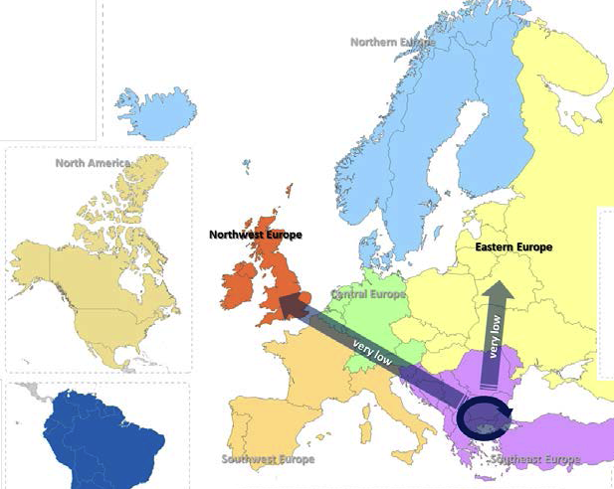
…. Reflecting in weak inter regional and cross regional cooperation models ….

Slide 21
Opportunity for Danube
Bio Based Value chains

Slide 22
Resources
Agriculture products (noon food)
Agriculture Waste
Food Waste
Forest – Wood
Cluster active in various relevant areas
Research well established in the region
Potential applications in emerging industry
Green Chemicals
Bio based materials
Bio Plastic
To be used
Advanced packaging
Medical devices
BioPharmaceuticals
Automotive

Slide 23
Policy level
Peer review to understand differences and short comes to be overcome in each region
Mapping of clusters to know actors
Cluster level
Benchmarking of cluster organizations
compatibilities,
synergies and
Improve capacity
Mapping relevant value chains
Strategy and Support schemes on Danube region and regions level accelerate bio based value chain development

Slide 24
Thank you
Anteja ECG d.o.o.
Lambergarjeva 8
1000 Ljubljana
Slovenia
Tel: +386 51 389 533
E-mail: info@anteja-ecg.com
Http://www.anteja-ecg.com

