Slide 1
TERRITORIAL COOPERATION PROGRAMMES FOR EUSDR - PA 8

Slide 2
Territorial Cooperation in a Nutshell
Defined in the specific European Territorial Cooperation Regulation (ETC Reg.)
Financed (manily!) by ERDF
Cooperation Programmes (4/11 TOs – max.)
Partners & Lead Partner
Specific Eligibility rules
Specific for PA8 – State aid issues (GBER)

Slide 3
Complementarities and Demarcation with EU-S
ETC and EUS NOT match made in heaven
Cooperation Programmes – assistance, not a main source of funding
RISK of loosing identity and purpose of both

Slide 4
Cohesion Policy and Territorial Cooperation
Goal 1: Investment for growth & jobs
EUR 316 billion
Goal 2: European Territorial Cooperation
EUR 8.9 billion
€
DANUBE
EUR 202 M
CENTRAL EUROPE
EUR 246 M
INTERREG EUROPE
EUR 359 M

Slide 5


(INTERREG C) INTERREG EUROPE (VC)
Research & innovation
SME competitiveness
Low-carbon economy
Environment & resource efficiency
2 actions
Interregional Cooperation Projects
Policy Learning
Platforms

Slide 6
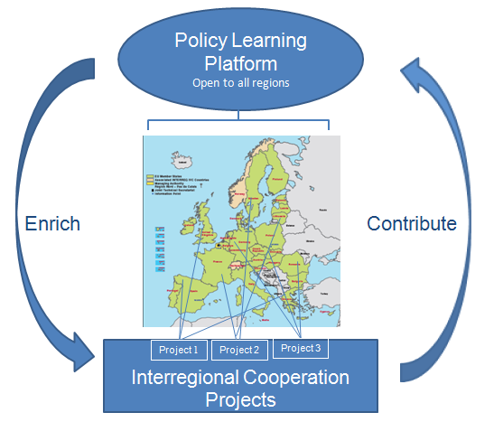
2 Interrelated actions

Slide 7
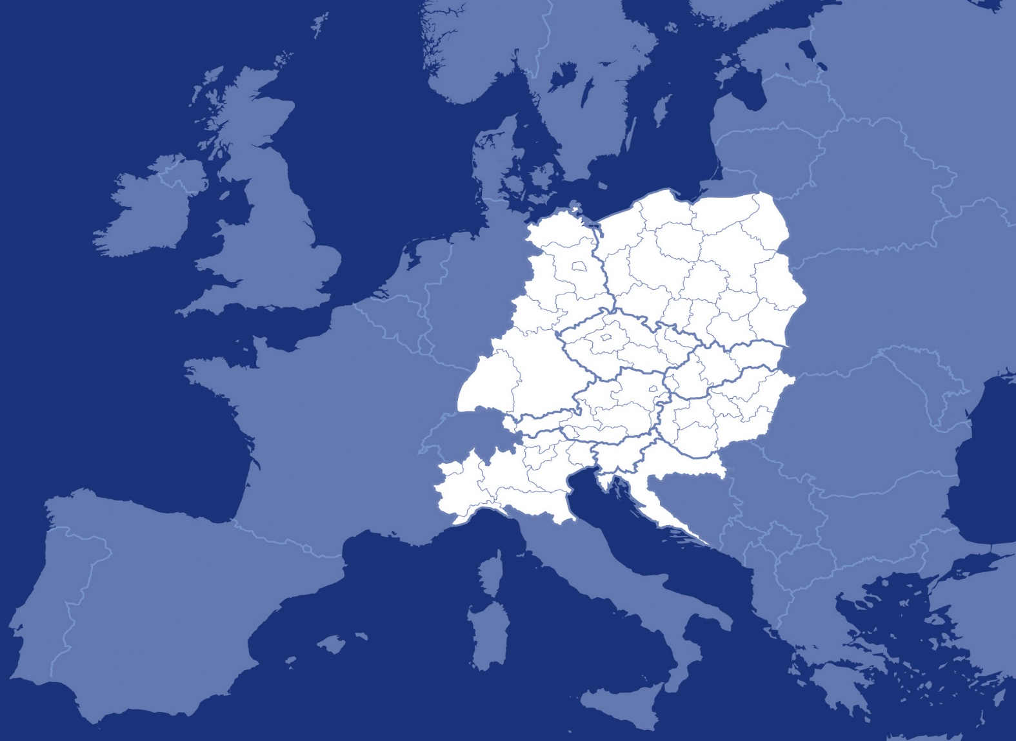
(INTERREG B) Central Europe

Slide 8
Programme Priorities
Cooperating on innovation to make CENTRAL EUROPE more competitive
Cooperating on low carbon strategies in CENTRAL EUROPE
Cooperating on natural and cultural resources for sustainable growth in CENTRAL EUROPE
Cooperating on transport to better connect CENTRAL EUROPE
Target groups: enterprises (including SMEs) and their employees, the public sector, intermediaries as well as private and public research institutions, R&D facilities, centres of R&D excellence.
Beneficiaries: Local, regional and national public authorities, regional development agencies, chambers of commerce, enterprises including SMEs, universities, tertiary education organisations, associations, technology transfer institutions, research institutions, centres of R&D excellence, NGOs, innovation agencies, business incubators, cluster management bodies, financing institutions, education and training centres as well as social partners and labour-market institutions.
To improve sustainable linkages among actors of innovation systems for strengthening regional innovation capacity
To improve knowledge and skills for advancing economic and social innovation

Slide 9
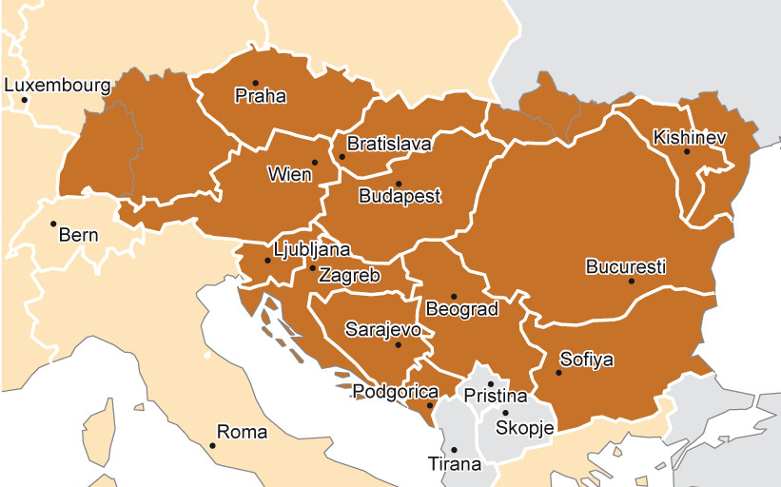
(INTERREG B) DANUBE

Slide 10
(INTERREG B) DANUBE
Late(r) start
TO 11b – support the implementation of MRS
Modalities of implementation – under discussion
Specific „TA type” support to PACs
Seed money type support
Problems and constraints: reporting, eligibility, financing, 3NO

Slide 11
Timeline
Deadline for submission of the programmes September 22nd 2014
Plan:
Submission of the programmes before summer (INTERREG EUROPE, CENTRAL)
Approval by the Commission in autumn
First calls for projects end of 2014/beginning 2015

Slide 12

Find more information…
www.mrrfeu.hr
www.interreg4c.eu
www.central2013.eu
Krešimir Ivančić
Ministry of Regional Development and EU Funds
Kresimir.Ivancic@mrrfeu.hr
+385 1 6391 979
facebook.com/Teritorijalna-suradnja-HR
facebook.com/interreg4c
facebook.com/CentralEuropeProgramme

