Slide 1
From low-cost manufacturing to innovation:
Romanian textile clusters promote creativity
3rd Workshop of Priority Area 8
10.03.2015, Vukovar, Jürgen Raizner

Slide 2
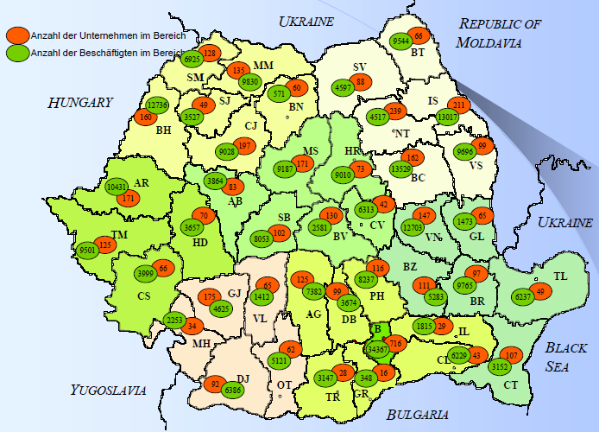
Textile Industry Romania
Main Characteristics
Competitiveness is (was) given by low salaries for employees and high quality in manufacturing
Manufacturing in „Lohn“
Customer provides knowledge,
fabrics, patterns, …
Sales and marketing focused
on small number of customers
Challenge: to remain competitive
2004!

Slide 3
Textile Industry: Future Competitiveness?
„An investigation by the Clean Clothes Campaign in ten eastern EU member states, including Romania, Bulgaria and Croatia, showed that working conditions are sometimes worse than in China and Indonesia.
…
Companies such as H&M, Zara, Hugo Boss, Adidas and Benetton pay their workers in Eastern Europe and Turkey the minimum legal wage, which is under the poverty threshold as defined by the European committee of social rights.”
Source: “Textile workers paid lower in Eastern Europe than in China, report finds”, 14.06.2014, EurActiv.com

Slide 4
The Cluster
Industrial members
Romanian Textile Concept Association with 28 enterprises
80 Mio. €; Export 70 Mio. €
3.000 employees
Cluster founded 2011
10 founding members; currently 23 members
Regional focus: Bucharest and Eastern Romania
www.romanian-textile.ro

Slide 5
Cluster Members: Innovative?
Companies that have implemented process innovation | No. | 3
Companies that have implemented product innovation | No. | 5
Companies that innovate in partnership | No. | 3
Patents (Brands, industrial designs, etc.) | No. | 11

Slide 6
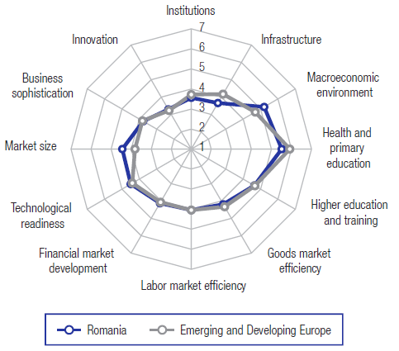
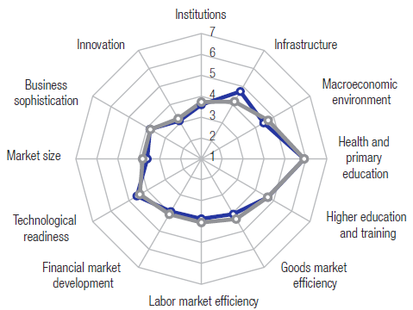
Innovation in Romania
Global rankings of Romania
Innovation: 66
Capacity for Innovation: 68
University-industry Coll. in R&D: 71
Croatia:
Innovation: 93
Capacity for Innovation: 124
University-industry Collaboration in R&D: 81
Global Competitiveness Report 2014/15

Slide 7
Success factors of innovation
Specific and precise Innovation Strategy
High competence in networking
Exact planning
Culture of innovation
Exchange within industrial sector
Support by top management
Inter-sectorial Exchange
To be supported
by Cluster ? !
Source: Excellence of Innovation in German Industries. Analysis of 116 large enterprises which mainly are among the 500 enterprises with highest turnover. 14 of 30 DAX companies participated.

Slide 8
Creativity: just one innovation process
Science
Curiosity
Creation of Basic
Knowledge
Advanced Vocational Training
Visions
Creativity
Structured operations
Knowledge
Idea
Prototype
Production,
Distribution
Innovation
Product-, Service-, Process-, Social-innovationen
Curiosity
Creation of Applied Knowledge
70-80% of all Innovations results from external Cooperations (Customers, Supplier,..) Cooperationen / Consortia / Clusters Eric von Hippel, 2002
Economy
Notes:
Innovationen:
Nachfrageorientiert (Snowboard, Skateboard) > vom Kunden ausgehend
Angebotsorientiert (MP3) > von der Wissenschaft ausgehend
Gründe für Innovationen: 1. Expansion; 2. Technologischer Wandel; 3. Gesellschaftlicher Wandel
Sequenzielle Arbeitsteilschritte bergen in den Unternehmen Konfliktpotenzial wegen unterschiedlichen Sichtweisen > Wichtig: Innovationsmanagement
> Auch problematisch: KVP, wenn Kultur nicht darauf ausgerichtet

Slide 9
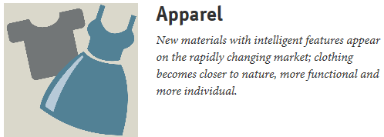
Research Subjects. Textile 1
www.textilforschung.de

Slide 10
Research Subjects. Textile 2
New markets in sectors:
food, health, mobility, architecture, energy, future city, production/lobistics
?
How to know about it?
How to understand it?
Some topics:
Intelligent materials and nanostructures
High-performance fibers, cellulose layers, nano-composites and intelligent functions in fibers
Chemistry, physics and technologies of fiber production
Synthesis of Fiber polymers, cellulosic fibers, spinnability and Fiber properties, structural investigations into fibers
Innovative textile finishing processes and chemistry of technical textiles
Optimisation of classic finishing processes, environmentally-friendly finishing, plasma treatment, innovative dyeing and printing processes, coating and laminating, surface modification and functionalization, nonwovens, super-absorbers

Slide 11
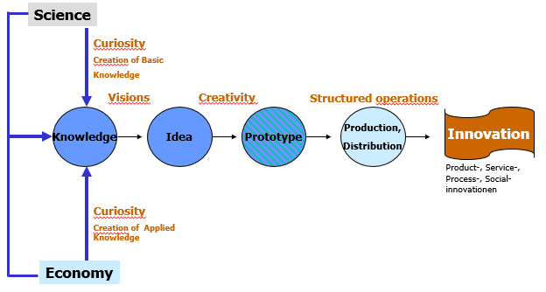
NOATEX. The Flagship Project of Romanian
Textile Cluster in EUSDR
Technological Centre NOATEX will be established in Romania as service provider for textile industry of all Danube Region. Information about latest technologies and high-tech materials will be made available to enterprises which have to translate this knowledge into marketable products.
Baden-Württemberg provides best practice. Other partners are highly welcome.
NOATEX will foster strong collaboration between science and industry.
NOATEX was presented at 3rd Danube Financing Dialogue in Bucharest and is a project in the bilateral work-programme of Baden-Württemberg – Romania.

Slide 12
Thank you for your attention!
Jürgen Raizner
Steinbeis Transfer Management S.R.L., Bucharest
www.steinbeis-romania.com / www.eusdr.com

